Slide 1
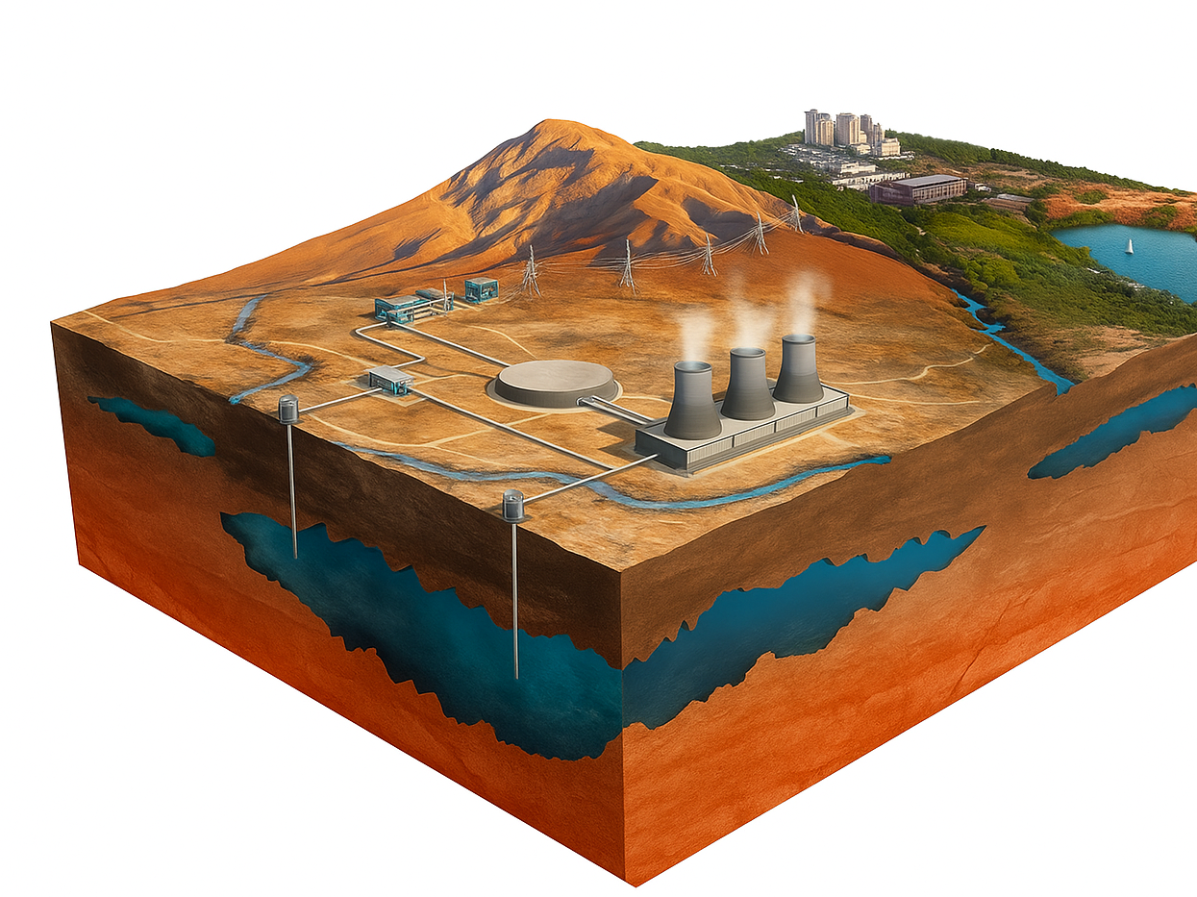

Geothermal CoGeneration
Integrating Geo Power and Thermal Systems
Tuesday September 23rd 2025
Matt Garlick CEM, CCP, BEMP
CEO, The GreyEdge Group
mgarlick@GreyEdgeGroup.com

Slide 2
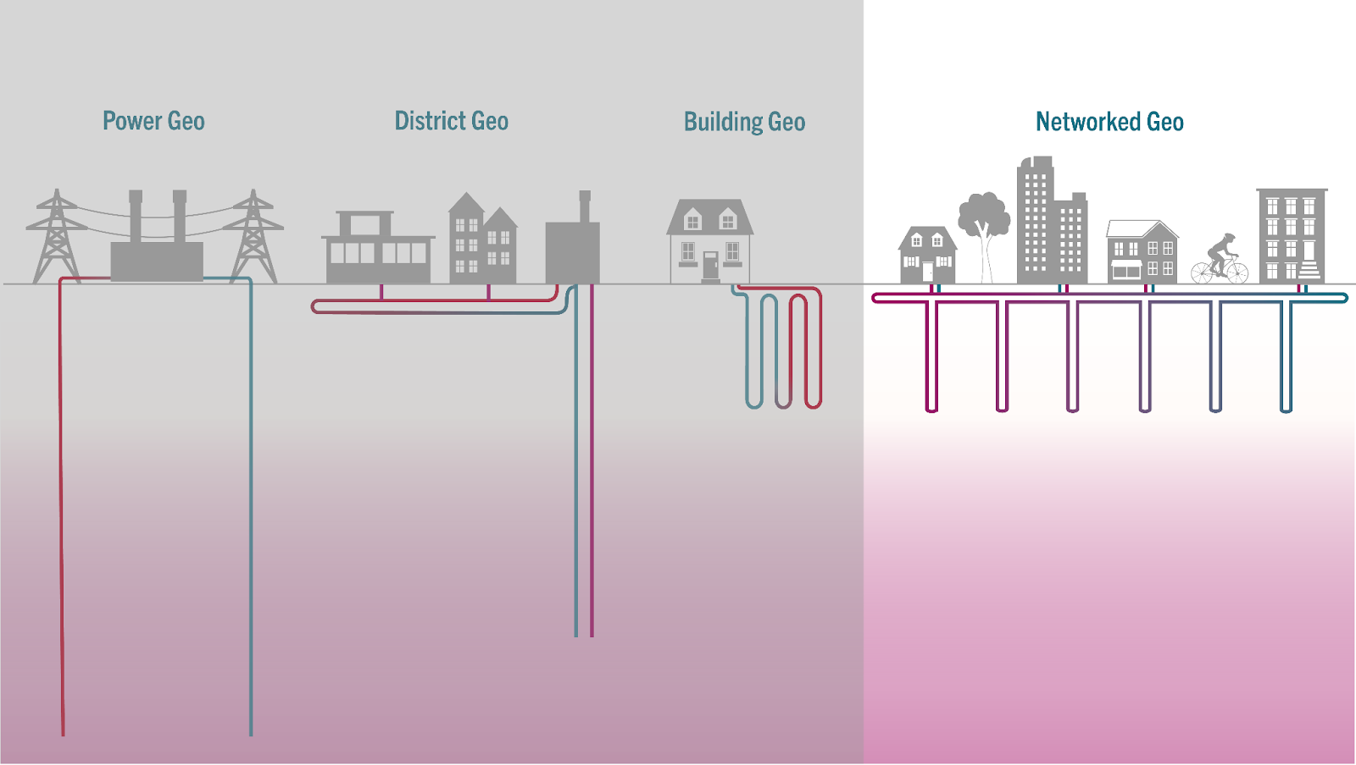
The Variety of Geothermal Systems
Thermal Energy Networks
Image Credit: HEET

Slide 3
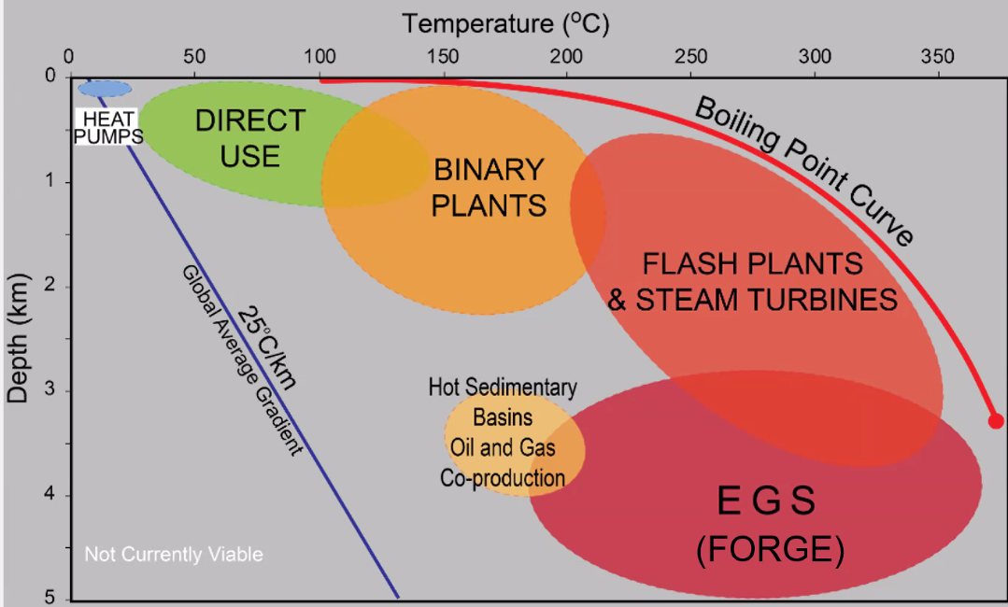
Geo Power System Boundaries
Simmons and Moore, 2013

Slide 4
The Enhanced Geothermal System Theory
EGS Reservoir Creation Process
Drill Injection Well
Hydraulically Fracture (Multiple Stages)
Drill Production Well to Intersect Fractures
Populate Well with Frac Stages
EGS Power Cycle
Injected Cold Water Circulates Through Hydraulic Fractures
Hot Water Brought to Surface Through Production Well
Flashed to Steam and/or Run Through Organic Rankine Cycle Binary Plant
Classical EGS Conceptual Schematic
Image Credit: McLennan

Slide 5
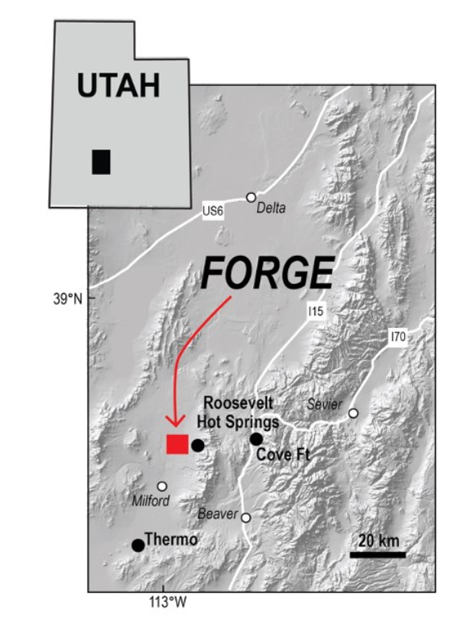
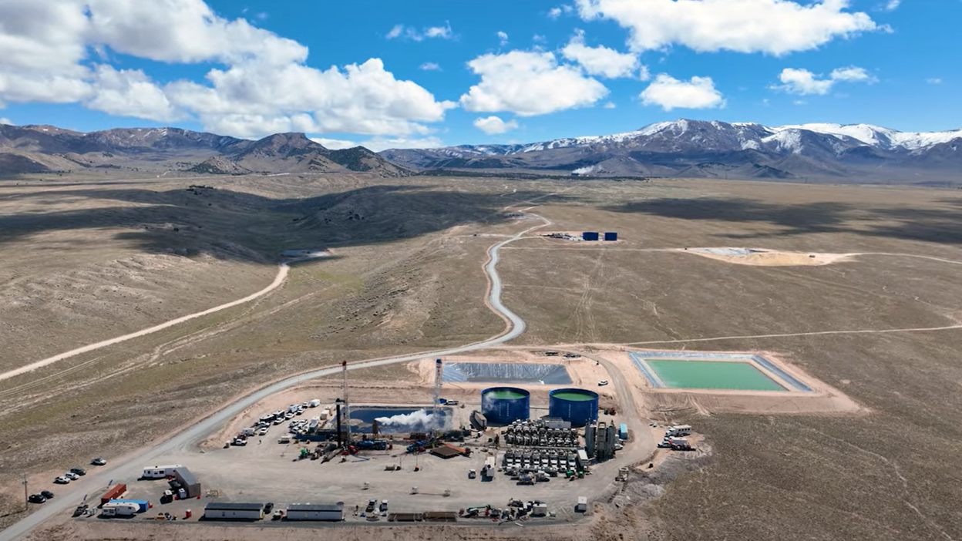
The FORGE Research Project

Slide 6
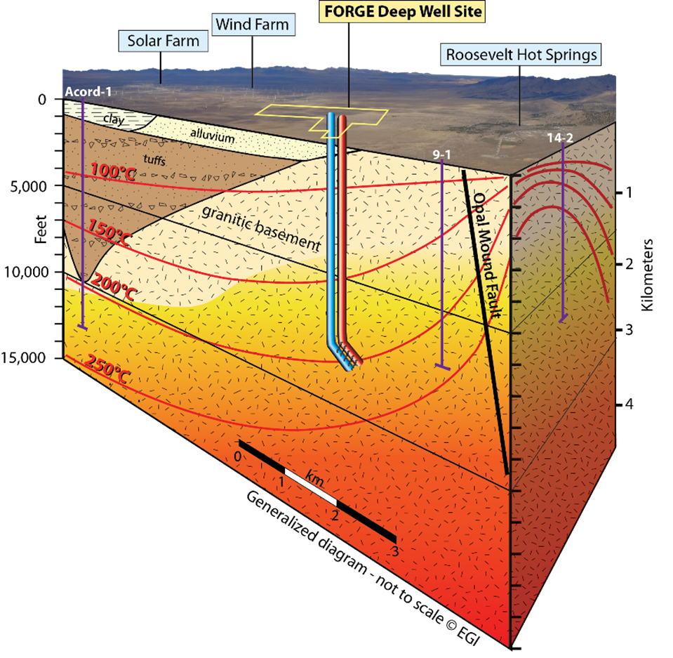
The FORGE Research Project
Temperature >350°F at depths >5000 ft
Low permeability rocks (granite)
Low risk from induced seismicity
Low environmental risks
No connection to hydrothermal system
Image Credit: McLennan

Slide 7
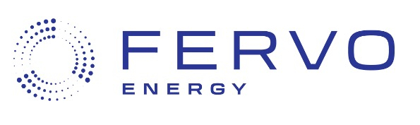
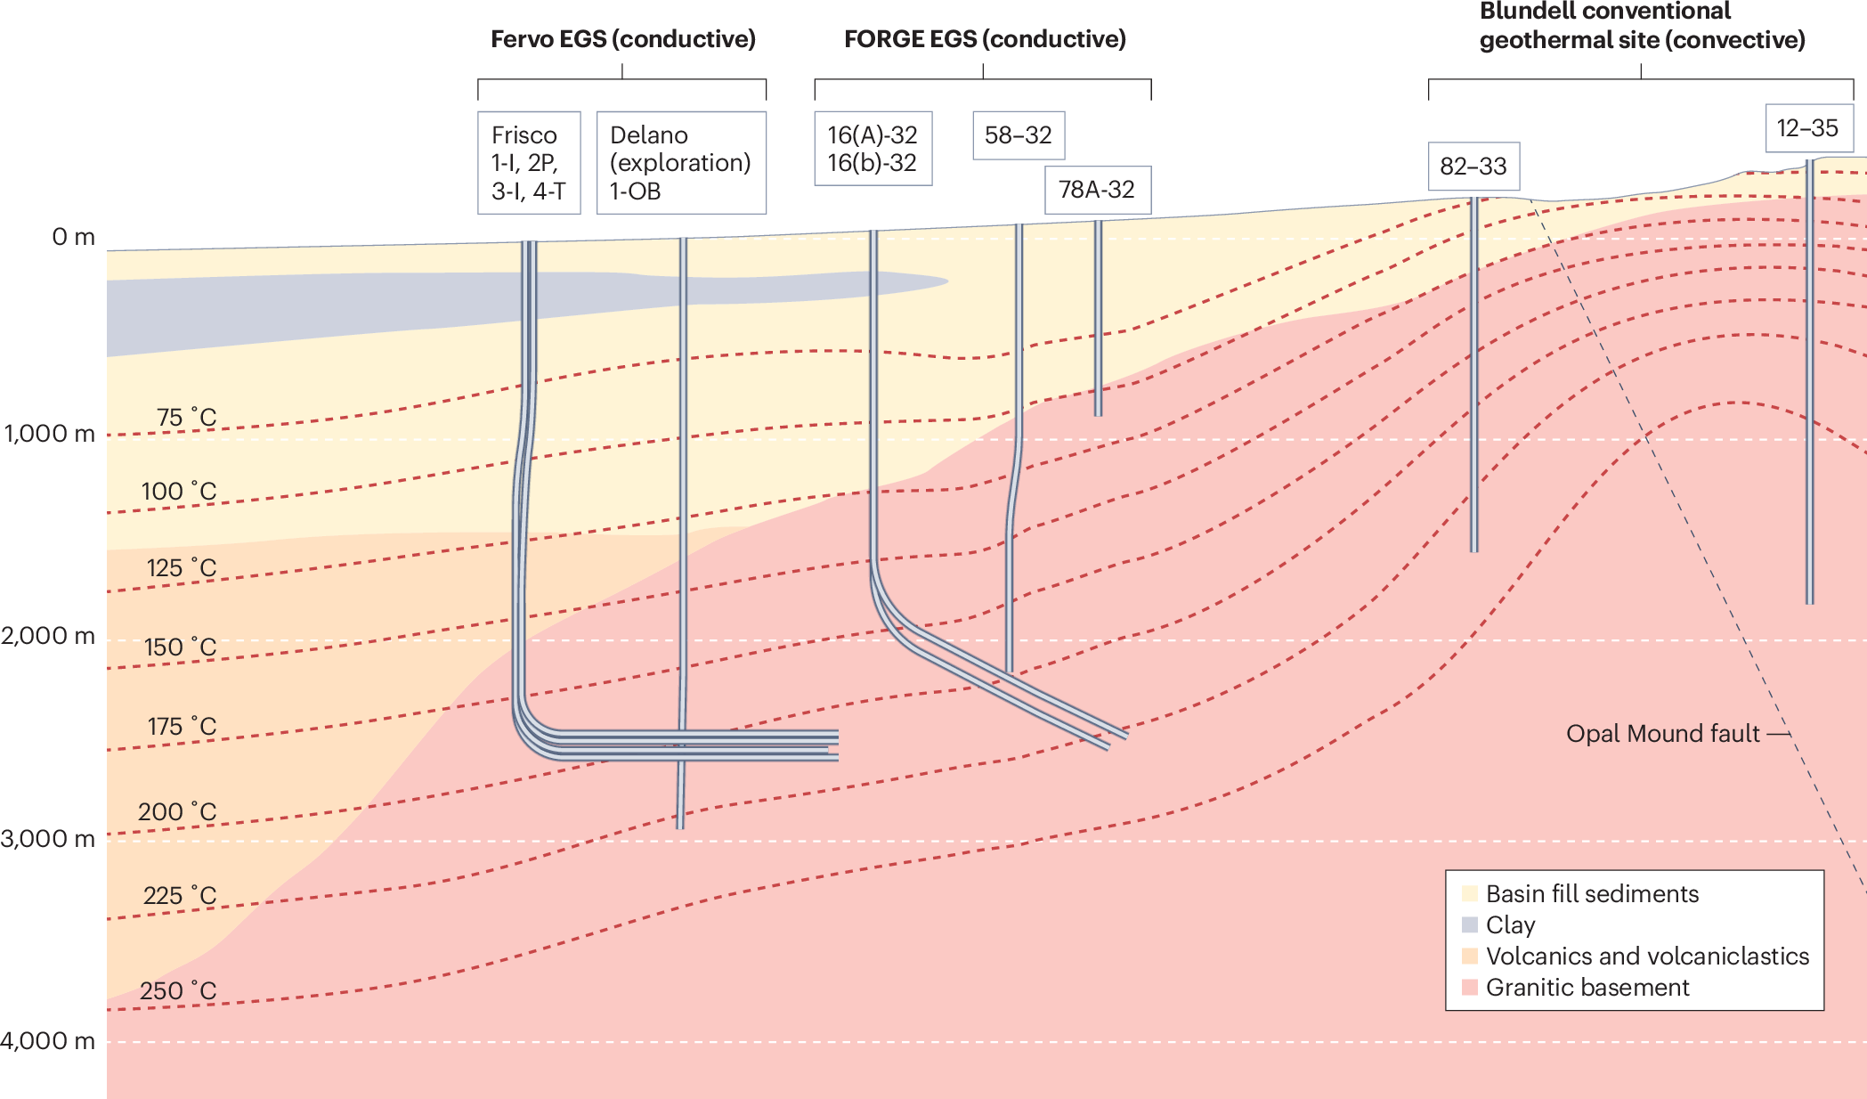
The Fervo Methodology- Enhanced Geothermal Systems
After Horne et al., 2025

Slide 8

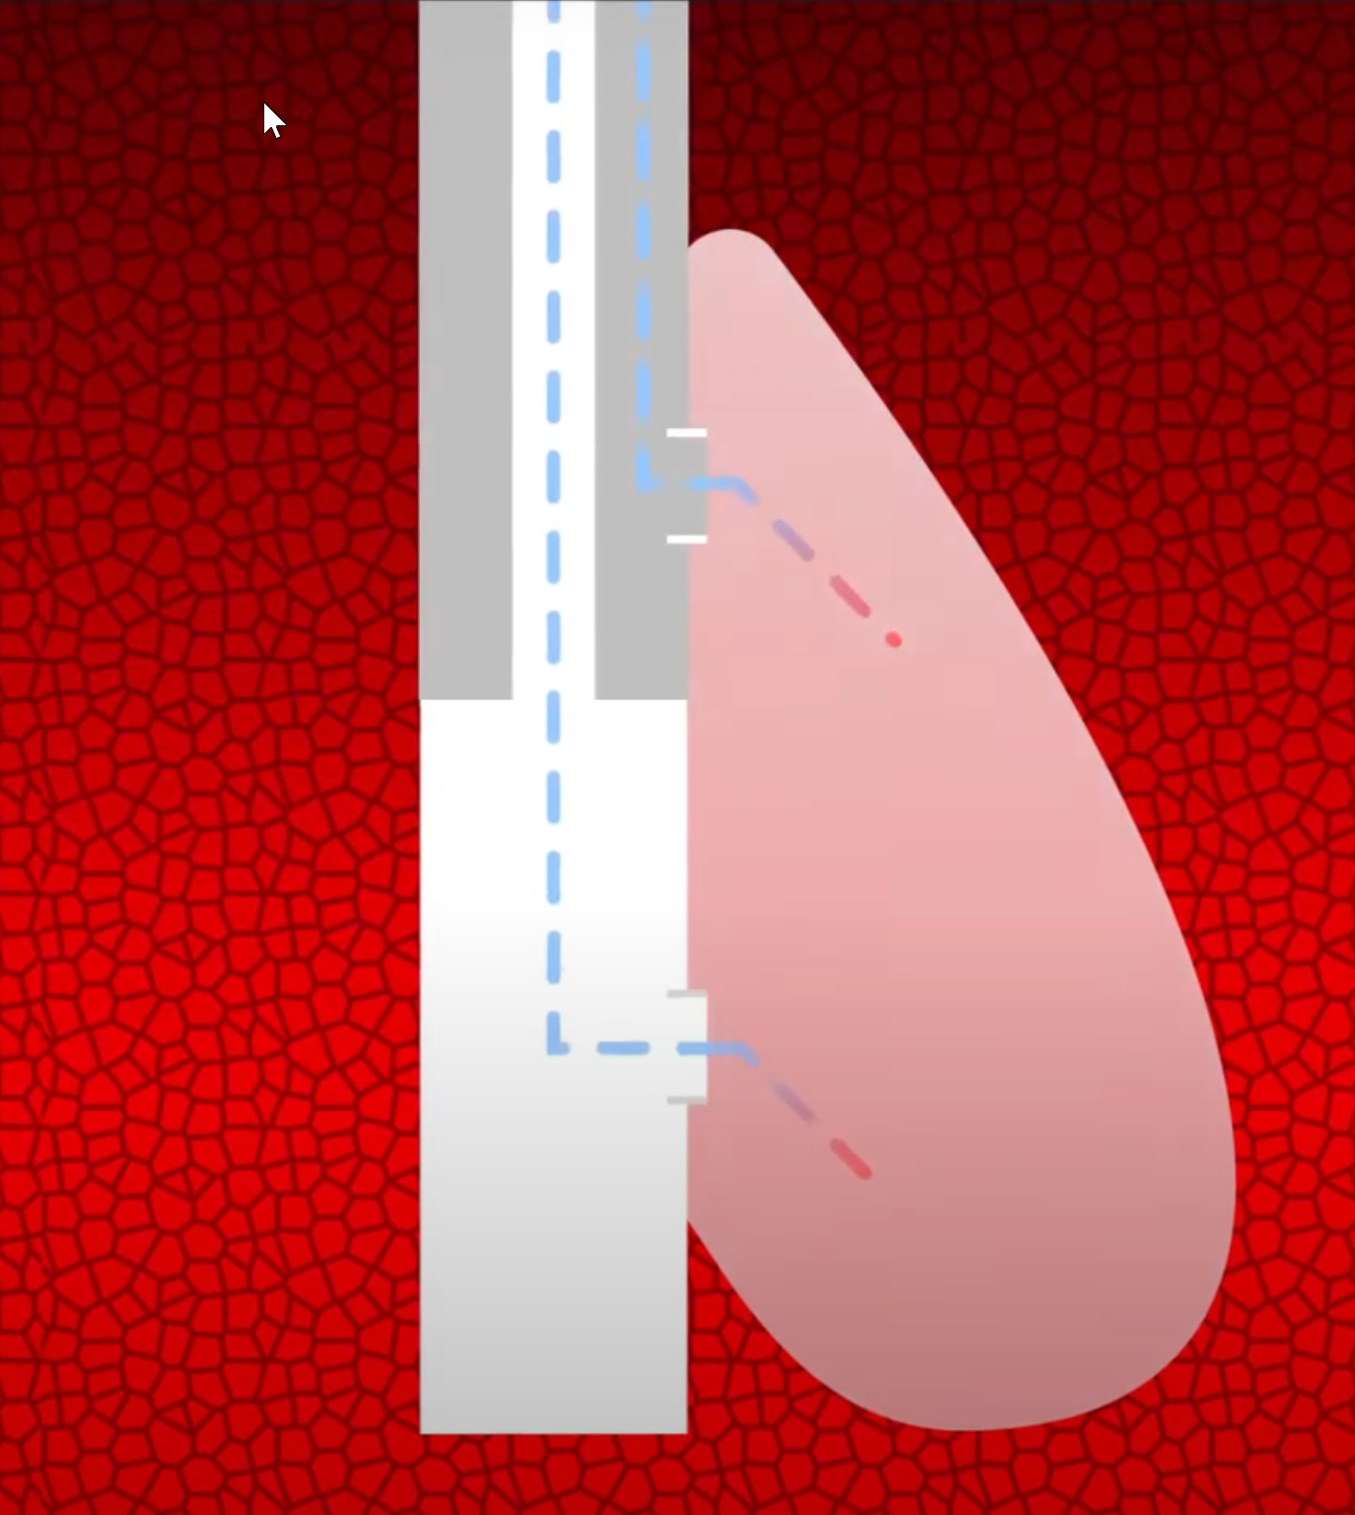
The Sage Methodology- Geopressured Long Duration Storage
Create a fracture that propagates downward
Circulate fluid into fracture for storage at temperature and/or for in situ heat-up
Energy associated with increased fracture width and storage of pressurized fluid is used to recover fluid on a schedule or as-needed basis.
https://www.sagegeosystems.com/

Slide 9
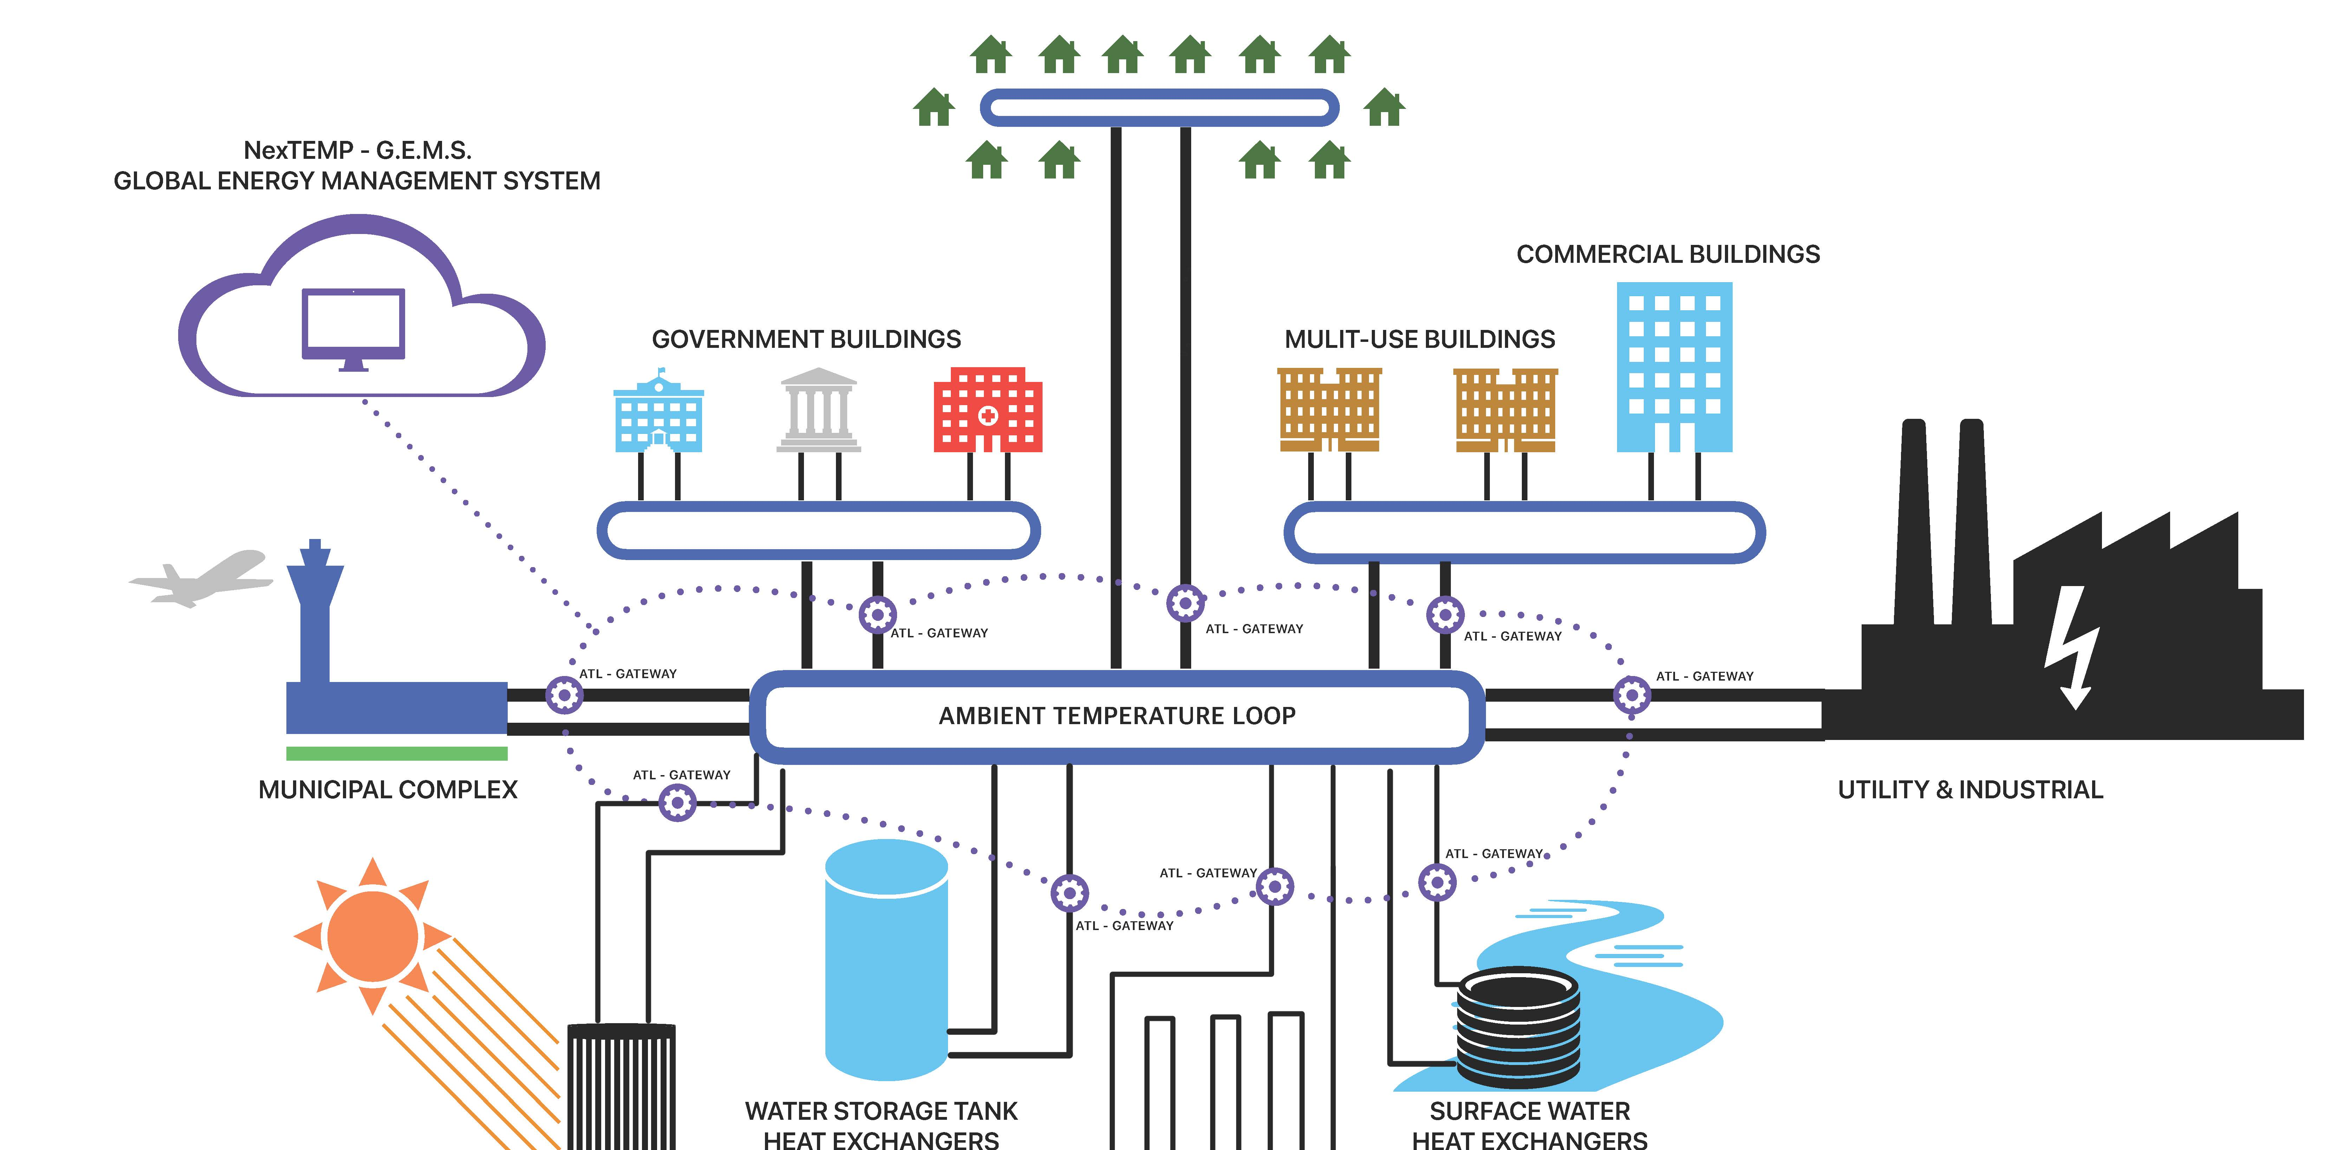
Thermal Energy Networks

Slide 10
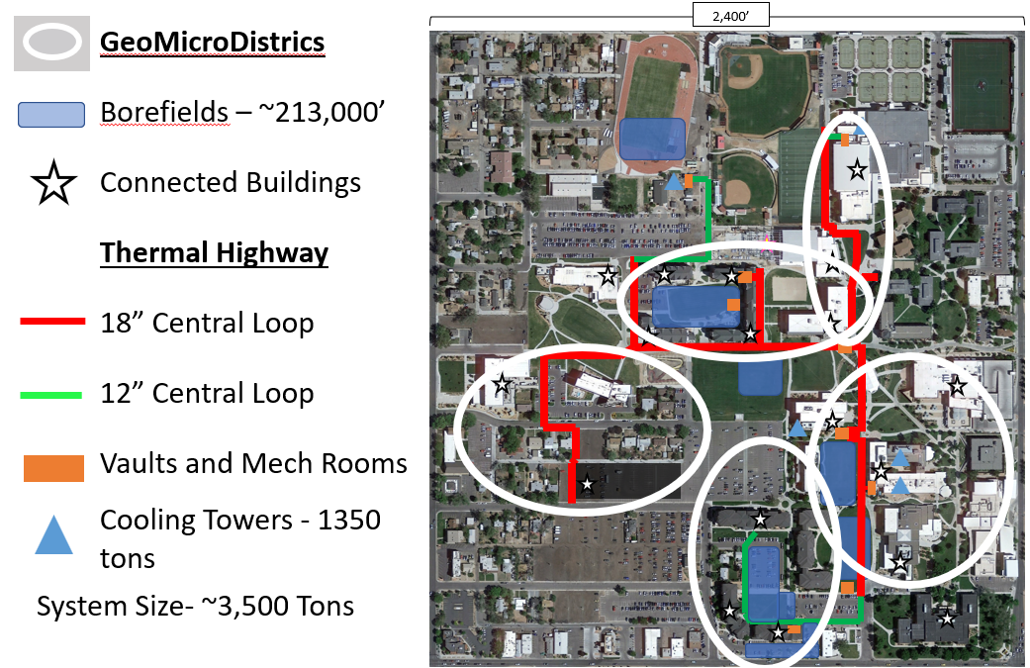
TEN Case Study- Colorado Mesa University

Slide 11
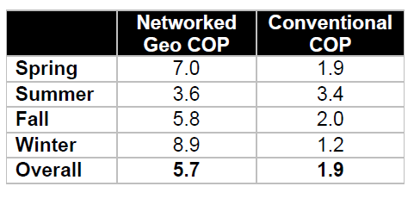
TEN Case Study- Colorado Mesa University
Without District System:
217 vertical feet of borehole per installed ton
Calculated water use: 14.5MM gallons/yr. (3,400 tons CT)
Electric Load 784 kW
With District System:
84 vertical feet of borehole per installed ton
Estimated Water Use: 4.5MM gallons (705 tons CT)
Electric Load: 185 kW
>$2,000,000 in annual utility savings
Study by Xcel Energy and performed by Michaels Energy

Slide 12
Combined Electric and Thermal Systems
What would this look like?
EGS systems provide stable, reliable baseload power
TENs provide clean, flexible thermal conditioning solutions
Where would this make sense?
Geologic considerations
Climate considerations (i.e., hot vs cold)
What benefits would this provide?
From a first cost perspective
From a utility perspective
From a space requirement perspective
Thermal Energy Networks
Image Credit: HEET

Slide 13
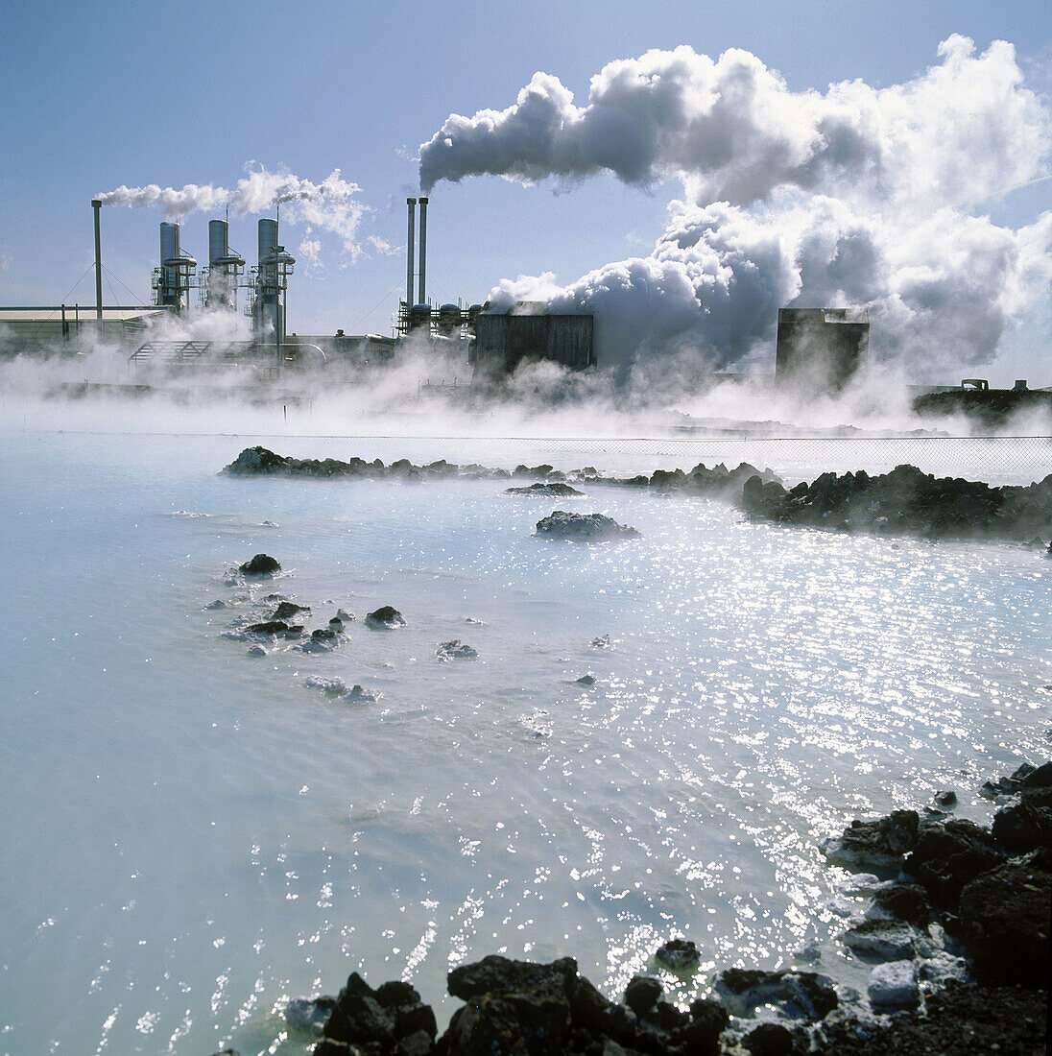
Is This Being Done? Svartsengi Power Plant, Iceland
FOAK power and district heating CoGen System in 1974
46 MW electric, 200 MWth District Heating
Wastewater creates the famous “Blue Lagoon”
Electricity serves 25,000 people, district heating for 20,000
https://www.imageprofessionals.com/

Slide 14
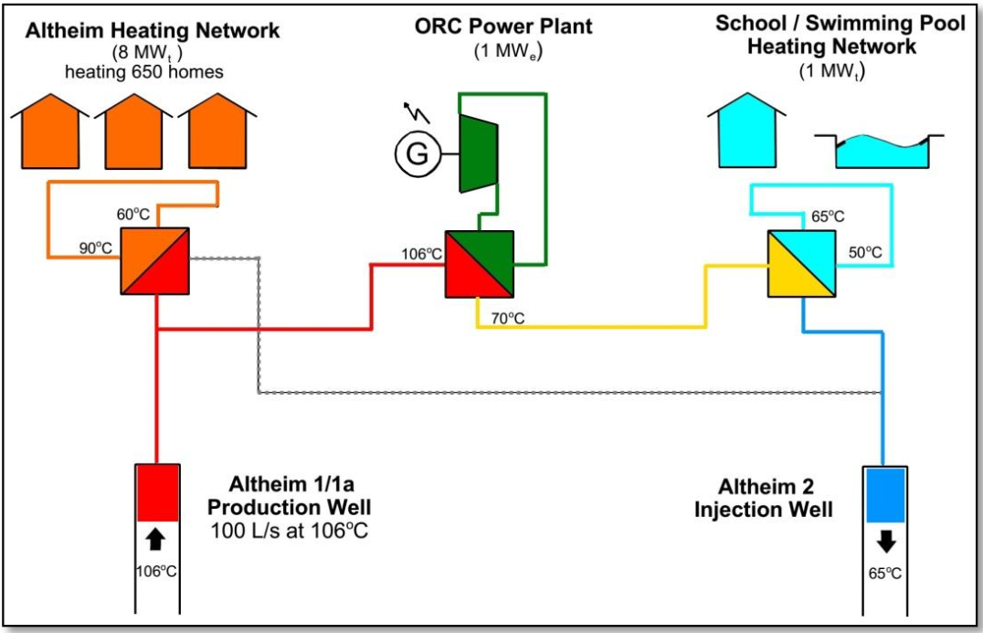
Is This Being Done? Altheim, Austria
Built in 1989 and expanded in 1994
1 MW Electric, 9 MWth District Heating
District heating for 650 residents
$0.05 USD/KWH and a 72% reduction in CO2
14.4 ROI on project
ECSAC2014_Cocianing_Altheim Presentation

Slide 15
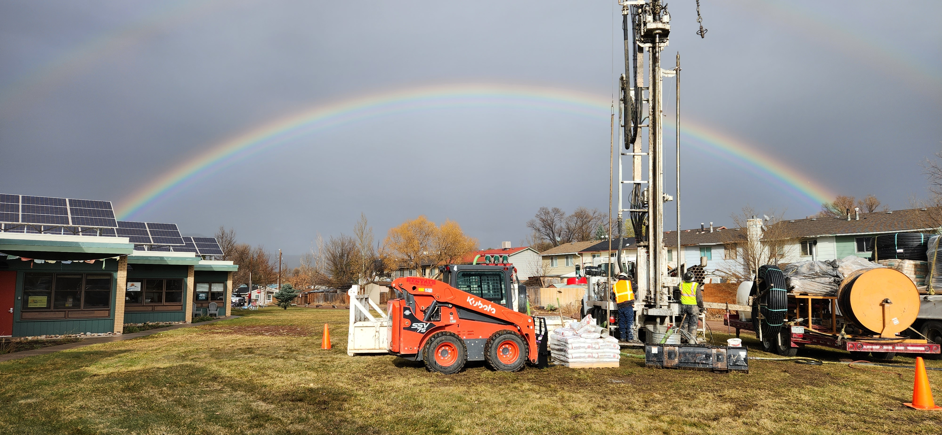
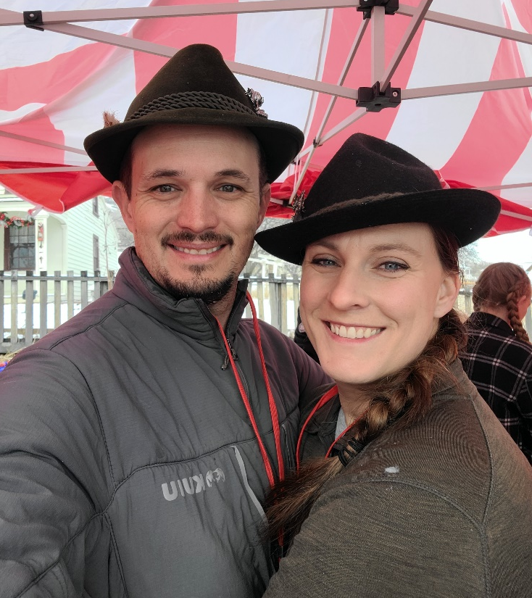
Thank You! Questions and Discussion
Matt Garlick CEM, CCP, BEMP
CEO, The GreyEdge Group
mgarlick@GreyEdgeGroup.com

